Slide 1
The Value of Location: What Matters Most for Older Individuals Considering Relocation in Sweden?
Nick Christie, Björn Slaug, Magnus Zingmark, Jonas Björk, and Susanne Iwarsson

Slide 2
Disclosure
The presenter has no relevant financial relationships, commercial interests, or conflicts of interest to disclose related to the content of this symposium.
All opinions and conclusions presented are based on the available evidence and the presenter’s professional judgment.

Slide 3
Study Aim & Research Question
When older adults in Sweden consider relocating, which neighbourhood features do they value most, and how much are they willing to pay for them?
We use a discrete choice experiment (DCE) to estimate willingness to pay for neighbourhood attributes among older adults in Sweden who are actively considering relocation.

Slide 4




What is a Discrete Choice Experiment?
Rooted in economics
Repeated choice tasks
DCEs originate in Lancaster (1966) consumer theory and McFadden's (1974) random utility model — awarded the Nobel Prize in Economics in 2000.
Respondents choose between hypothetical alternatives that differ on predefined attributes — mimicking real trade-offs. Repeated 9 times per respondent.
Stated vs revealed preferences
Willingness to pay
Unlike revealed preference data, DCEs let us observe trade-offs that rarely occur in real markets — essential for studying older adult relocation.
By including a cost attribute, we convert choice patterns into monetary values: how much (in SEK/month) would someone pay for a better location?

Slide 5





The five housing attributes in the experiment
Green Space
Levels: 500 m | 5 km | 15 km
Shops & Services
Levels: 500 m | 5 km | 15 km
Public Transport
Levels: 300 m | 600 m | 900 m
Parking
Levels: None | Reserved space | Garage
Monthly Cost (compared to planned)
Levels: −20% | −10% | 0% | +10% | +20%

Slide 6
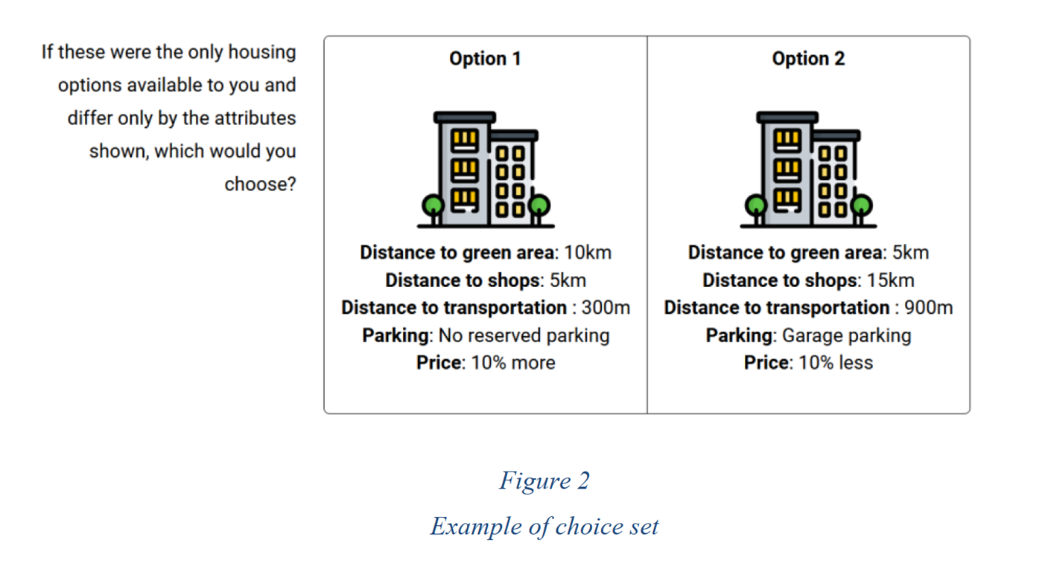
What respondents actually saw — an example

Slide 7
From choices to monetary values
Willingness to Pay (WTP) = the maximum extra amount per month a person would pay to get a better version of an attribute
Respondent prefers:
We observe this:
We estimate utility coefficients (via mixed logit regressions) then calculate:
Result
Option with green space 500m
even though it costs more
Across 9 choice sets,
957 people
How much extra cost they'd
accept for that green space
"Owners: 397 SEK (€35)/month
for green space at 500m (compared to 15km)"
→
→
→

Slide 8
Respondents generally prefer better locations — but how much?
All four attributes attracted positive preferences on average — closer was generally preferred. Estimated WTP among homeowners shown below (SEK/month; 1 EUR ≈ 11.42 SEK):

Slide 9
Homeowners vs Renters — Willingness To Pay (WTP) comparison
Homeowners show higher WTP on average — this appears to reflect lower price sensitivity rather than weaker preferences among renters. Values in SEK/month (divide by 11.42 for EUR).

Slide 10
The parking puzzle — same preference, half the price?
Utility coefficients for parking are nearly identical between owners and renters — they both want it equally. The monetary gap reflects budget constraints, not preference.
Homeowners 🏠
Renters 🏢
587 SEK = €51/month
254 SEK = €22/month
for a reserved garage
for a reserved garage
💡 Key insight: The price-sensitivity of renters (cost coefficient nearly 2× owners) explains most of the monetary gap. Renters may face real financial barriers to accessing well-located housing.

Slide 11



Does age matter?
Age group split at 72 (the sample median). Most preferences stable — but public transport becomes notably more important with age.
Transport: larger change
Green Space: stable
Shops: slight change
Older homeowners (72+) had estimated WTP of 136 SEK (€12)/month for a stop within 600m, vs 15 SEK (€1) among younger owners.
Public transport may become more important as mobility declines.
Preferences for green space remain broadly similar across age groups.
Benefit of nature for wellbeing doesn't fade with age.
Older renters willing to pay 84 SEK (€7)/month less for very close shops, possibly reflecting changing consumption patterns in later life.

Slide 12
Do men and women prioritise differently?
Five statistically significant gender differences among homeowners. No significant gender differences found among renters. Values in SEK/month (divide by 11.42 for EUR).
Women value more…
🌿 Green space 500m: women 478 SEK (€42) vs men 313 SEK (€27)/month
🚌 Transit 300m: women 288 SEK (€25) vs men 157 SEK (€14)/month
🛒 Shops 5km: modest but significant difference
Men value more…
🚗 Garage: men 624 SEK (€55) vs women 550 SEK (€48)/month

Slide 13
Does health status shape preferences?
Health shapes mobility-related preferences most strongly — green space for the healthy, transport for those with poorer health.
Better health - Owners
Poorer health - Owners
🌿 Green space 500m (vs 15km): 416 SEK (€36)/month
🌿 Green space 500m (vs 15km): 293 SEK (€26)/month
🚌 Transport 600m (vs 900m): 47 SEK (€4)/month
🚌 Transport 600m (vs 900m): 164 SEK (€14)/month
💡 Active people may benefit more from nearby green space
💡 Declining ability may increase reliance on public transport

Slide 14
In conclusion
Location is central to housing choice
Older adults actively considering relocation place significant monetary value on neighbourhood accessibility — shops, green space, transport, and parking all consistently increase utility
Most preferences are shared across subgroups
Shops, green space and parking are broadly valued regardless of age, gender, or health — the case for neighbourhood accessibility is robust
Public transport is the key policy lever
Transport access showed the largest variation across age and health groups — it warrants targeted attention, especially for those in poorer health and advanced age
Renter inequality deserves policy attention
Renters value accessible locations as much as owners but face real financial barriers — market mechanisms risk reinforcing spatial inequality in later life

Slide 15

Thank you!
nick.christie@med.lu.se

